Slide 1
Sequence Modeling in Vision
Harish Kashyap: harish@pandita.ai

Slide 2

Harish Kashyap: harish@pandita.ai
An Entrepreneur and an expert in machine learning, robotics, big data, generativeAI and signal processing
Over a decade of experience as a researcher across various industries, including Amazon Robotics, KLA Tencor and BBN Technologies
Career highlights include leading the development of AI-driven algorithms that interact with robotic systems
Founder of two companies: Mysuru Consulting Group(MCG) and Pandita AI
GitHub: https://github.com/harishkashyap
LinkedIn: https://www.linkedin.com/in/hkashyap/

Slide 3
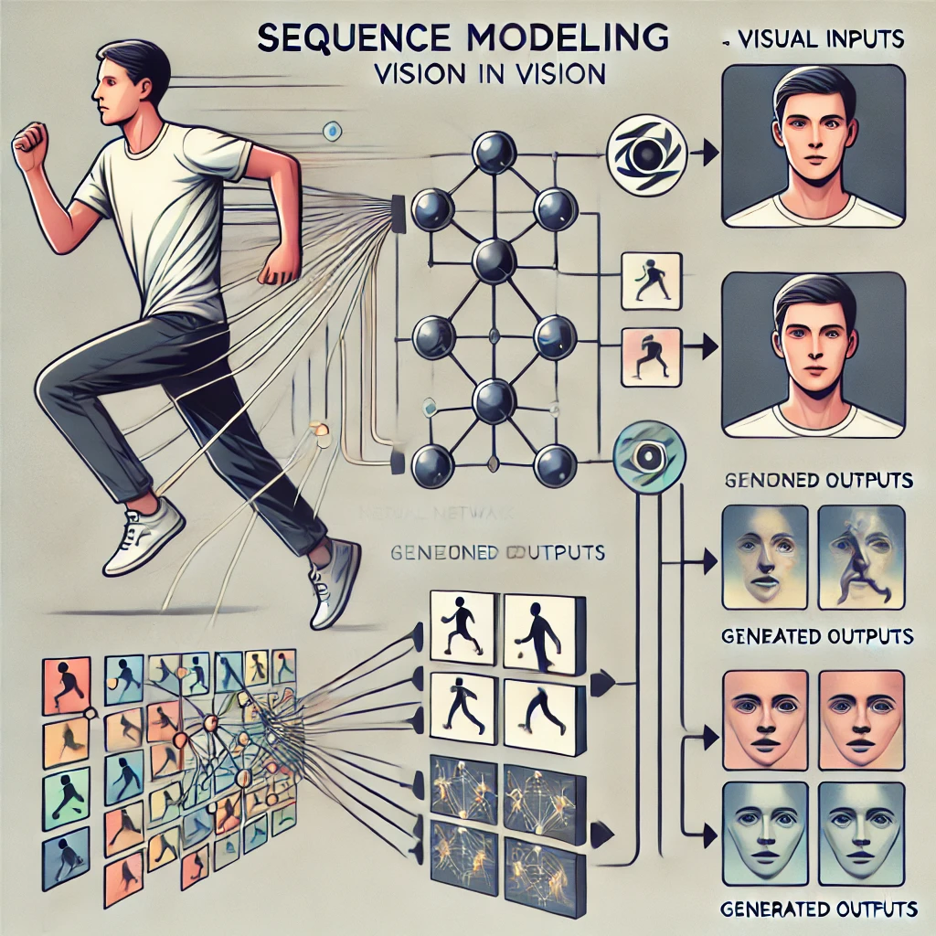
Sequence Modeling in Vision
Definition:
Sequence modeling predicts or generates sequential data using neural networks.
Why Vision?:
Many vision tasks (e.g., video understanding, image captioning) have inherent temporal or sequential relationships.
Key Idea:
Sequence modeling captures dependencies between elements in a sequence (e.g., frames in a video).
Examples in Vision:
Understanding action sequences in videos.
Generating captions that describe an image.
Importance:
Essential for bridging visual and temporal information.

Slide 4
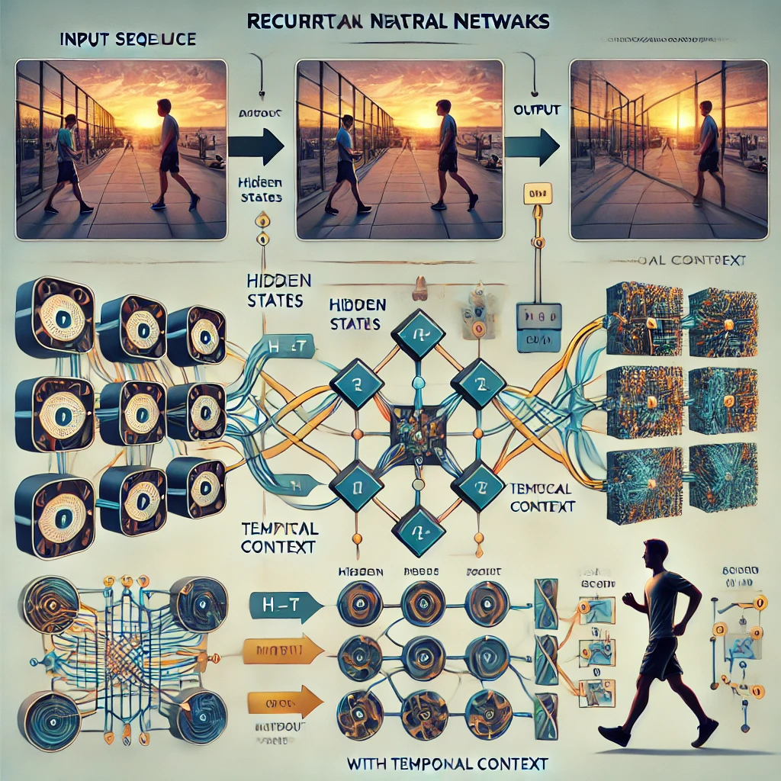
Recurrent Neural Networks (RNNs) in Computer Vision
What are RNNs?
Neural networks designed to process sequential data, such as video frames or image sequences.
Use feedback loops to maintain temporal context.
How RNNs Work in Vision:
Process sequences like video frames one step at a time.
Maintain a hidden state to capture temporal dependencies across frames.
Why RNNs for Vision?
Capture the temporal relationships in video or sequential data.
Enable tasks such as:
Action recognition in video sequences.
Motion prediction and anomaly detection.
Challenges in Vision:
Computational cost increases with long sequences.
Struggles with long-term dependencies due to vanishing gradients.

Slide 5
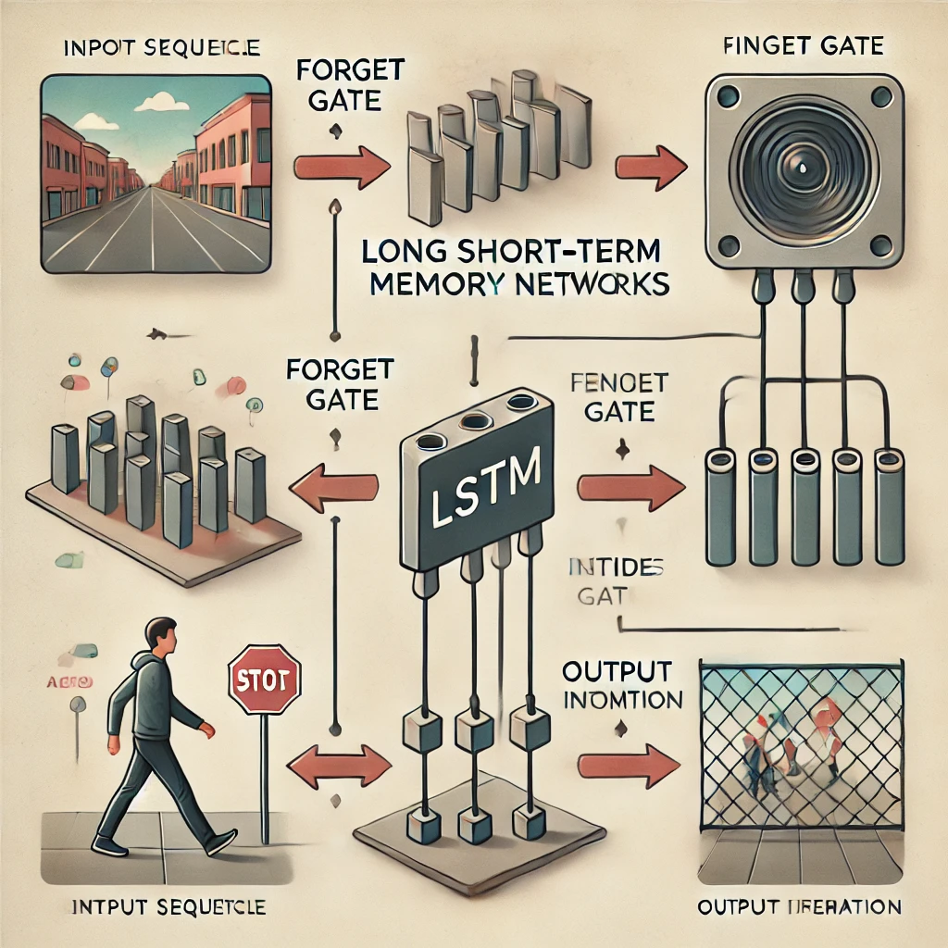
Long Short-Term Memory Networks (LSTMs) in Computer Vision
What are LSTMs (Long Short-Term Memory Networks)?
A type of RNN designed to solve the vanishing gradient problem.
Introduced memory gates (input, forget, and output) for better control over the flow of information.
Key Features:
Forget Gate: Decides which information to discard.
Input Gate: Determines which new information to store in memory.
Output Gate: Selectively passes information to the next layer or step.
Advantages in Vision:
Captures temporal dependencies across video frames.
Handles long-term dependencies better than traditional RNNs.
Applications in Computer Vision:
Action Recognition: Detecting actions like walking or running in video sequences.
Temporal Scene Understanding: Understanding the flow of events in videos.
Video Summarization: Selecting key frames or events from video content.
Limitations:
Computationally expensive due to complex gate structures.
Requires significant memory and resources for large datasets.

Slide 6
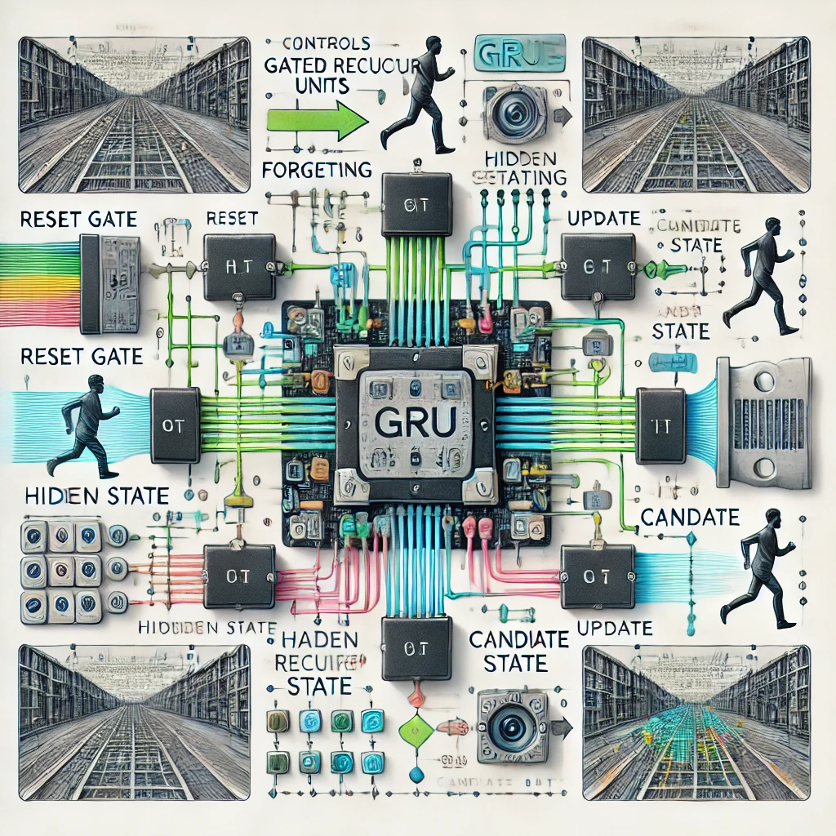
Gated Recurrent Units (GRUs) in Computer Vision
What are GRUs (Gated Recurrent Units)?
Simplified version of LSTMs with fewer parameters.
Combines input and forget gates into a single Update Gate.
Uses a Reset Gate to manage the flow of information within the unit.
Key Features:
Faster training compared to LSTMs.
Fewer parameters make GRUs computationally efficient.
Often achieves similar performance to LSTMs in many tasks.
Why Use GRUs in Vision?:
Efficiently process visual sequences like videos.
Suitable for tasks with limited computational resources.
Applications in Computer Vision:
Action Recognition: Identify actions in video sequences.
Gesture Recognition: Analyze hand or body movements.
Temporal Event Prediction: Predict next events in sequential visual data.
Limitations:
May underperform in cases requiring complex long-term dependencies.

Slide 7
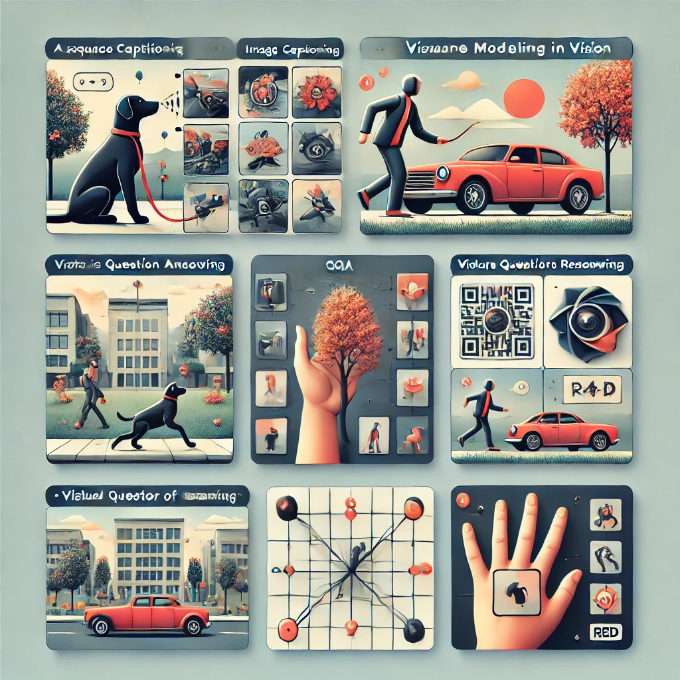
Applications of Sequence Modeling in Vision
Image Captioning: Generates textual descriptions of images using CNNs and RNNs/LSTMs. Example: "A dog playing in the park."
Visual Question Answering (VQA): Answers questions based on images. Example: Q: "What is the color of the car?" A: "Red."
Action Recognition: Identifies actions like "walking" or "running" from video sequences.
Video Summarization: Selects key events or frames to summarize videos.
Gesture Recognition: Recognizes hand or body movements for applications like AR/VR.

Slide 8
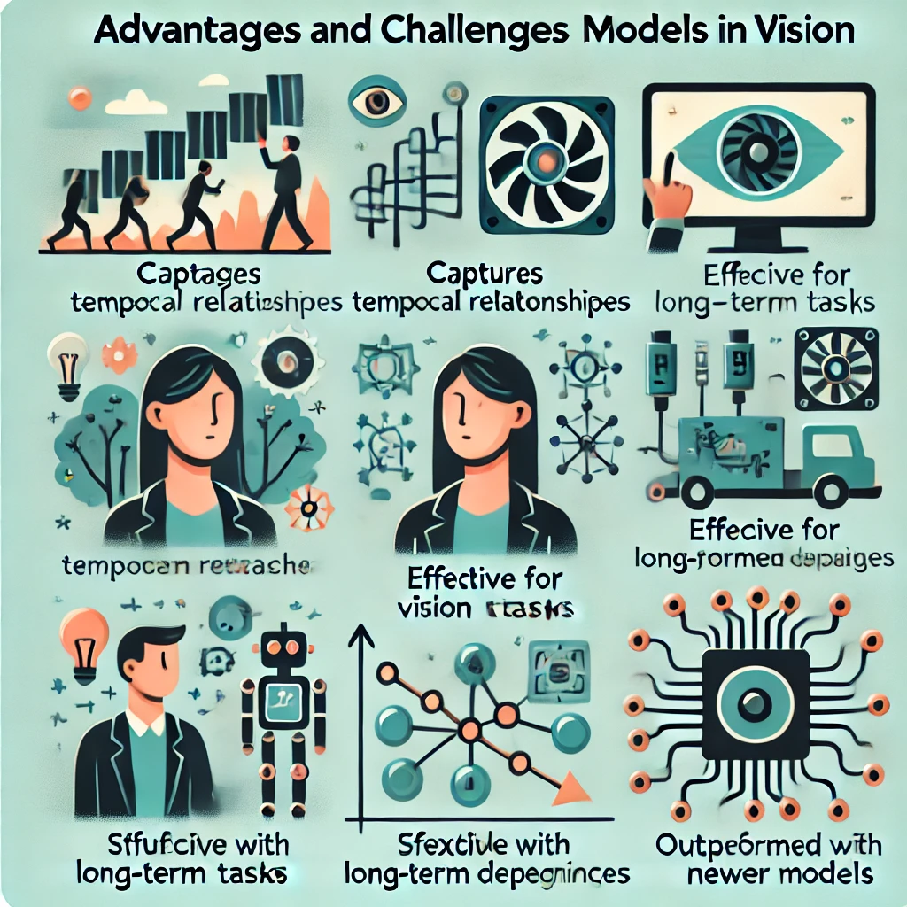
Advantages and Challenges of Sequence Models in Vision
Advantages:
Captures temporal relationships in vision tasks.
Effective for combining visual and textual data (e.g., Image Captioning, VQA).
Adapts to tasks like action recognition and video summarization.
Challenges:
High computational cost for long sequences.
Struggles with long-term dependencies (vanishing gradients).
Less scalable for large datasets compared to newer models (e.g., Transformers).

Slide 9
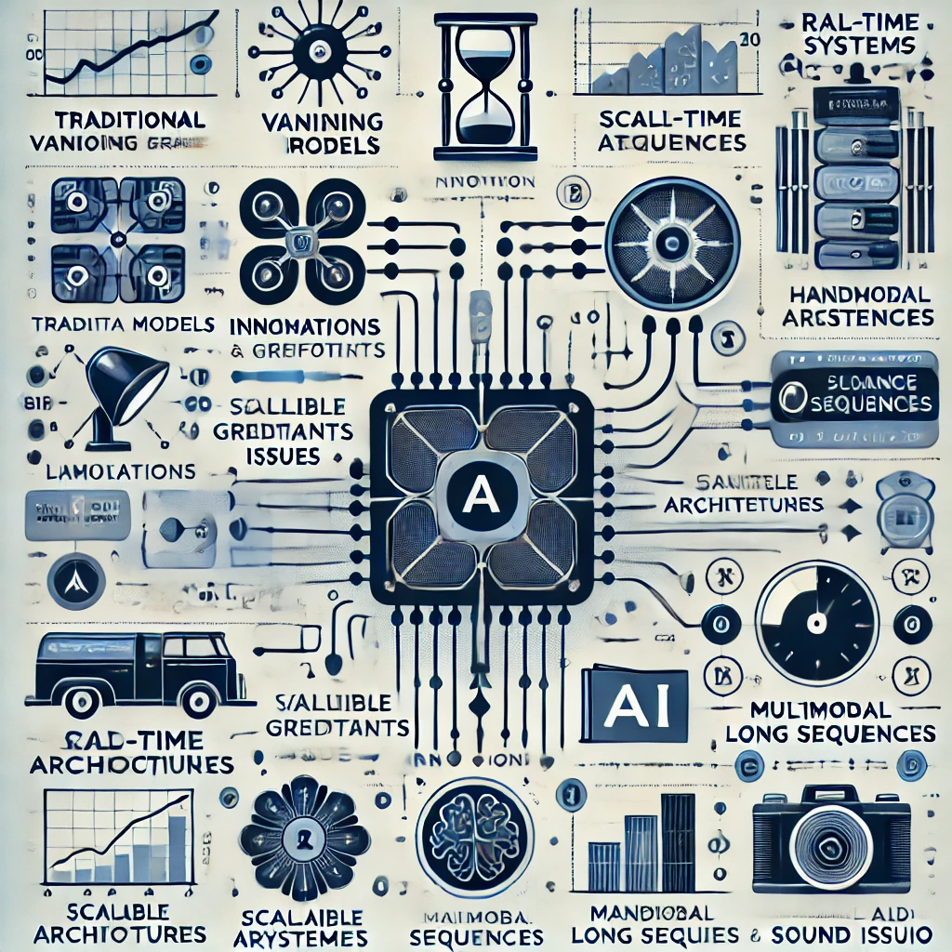
Innovations and Future Directions
Innovations:
Transformers and Attention Mechanisms:
Overcome RNN/LSTM limitations with self-attention.
Scalability for long sequences and large datasets.
Applications: Video understanding, image captioning, and VQA.
Multimodal Learning:
Combines vision and text for advanced tasks.
Examples: DALL·E (image generation) and CLIP (image-text alignment).
Future Directions:
Real-Time Systems:
Models like FastNeRF enabling interactive applications.
Scalable Architectures:
Improved performance for large-scale datasets and long video sequences.
Integration with Multimodal AI:
Bridging vision, text, and audio for comprehensive learning.

